Slide 1
P4 Programming to implement Simple Switch
Chethan Nagesh Pal
Akshit Rastogi
Joseph kuncheria

Slide 2
Programming protocol-independent packet processors(4ps)
P4 is an open source programming language that lets end users dictate how networking gear operates.
It controls silicon processor chips in network forwarding devices such as switches, routers and network interface cards.
Whereas currently network functions are built “bottoms-up” with fixed-function switches having one way of forwarding packets, programmable networks can be controlled “top-down” to install any functionality the user wants.

Slide 3
Advantages
Easily add new features: Network silicon chips can be programmed to support new protocols (BGP, OSPF, Spanning Tree, etc)
Remove unused protocols: Just as new network protocols can be installed onto the chip, likewise, unused protocols can be removed, freeing up space for it to focus solely on what the user wants it to do.
Greater visibility: P4 allows users to program in rules to forwarding devices. It can, for example, create a tag for each packet as it passes through a router or switch. Doing so lets network engineers get a potentially unprecedented level of visibility into the routing paths of packets to determine network latency.

Slide 4
A P4-programmable switch differs from a traditional switch in two essential ways:
The data plane functionality is not fixed in advance but is defined by the a P4 program. The data plane is configured at initialization time to implement the functionality described by the P4 program (shown by the long red arrow) and has no built-in knowledge of existing network protocols.
The control plane communicates with the data plane using the same channels as in a fixed-function device, but the set of tables and other objects in the data plane are no longer fixed, since they are defined by a P4 program. The P4 compiler generates the API that the control plane uses to communicate with the data plane.

Slide 5
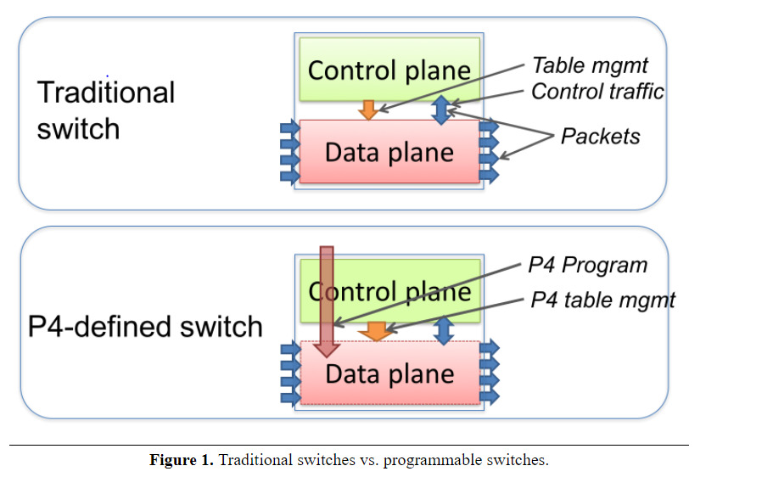

Slide 6
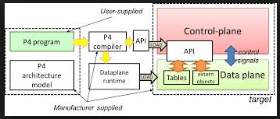
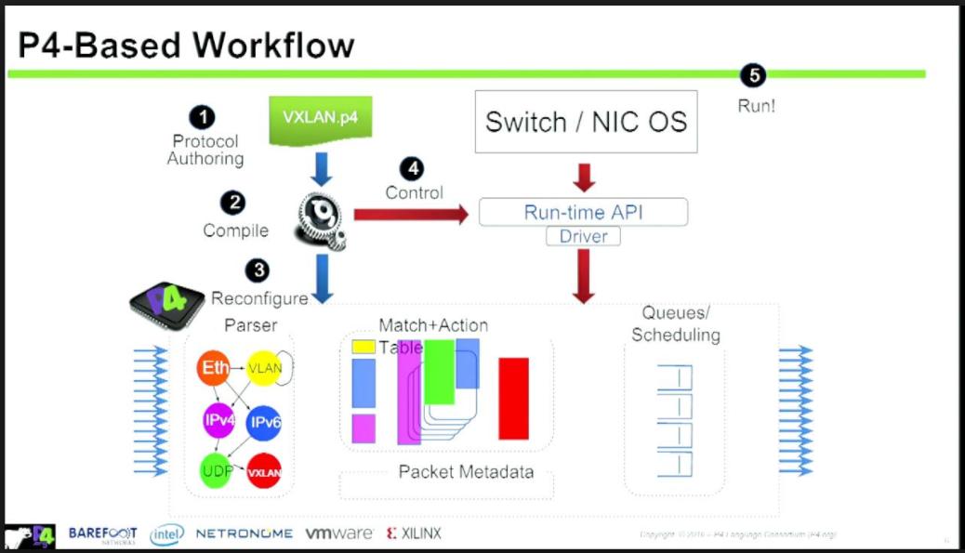

Slide 7
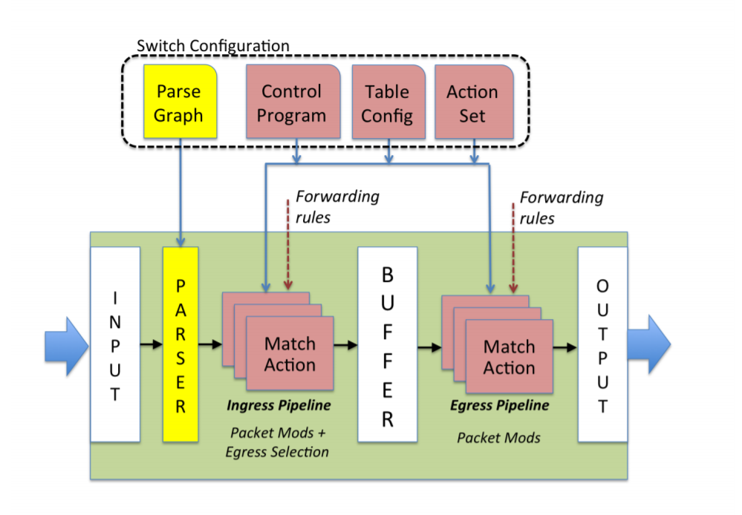
P4 architecture

Slide 8
P4 architecture
The forwarding model is controlled by two types of operations: Configure and Populate. Configure operations program the parser, set the order of match+action stages, and specify the header fields processed by each stage.
Configuration determines which protocols are supported and how the switch may process packets. Populate operations add (and remove) entries to the match+action tables that were specified during configuration. Population determines the policy applied to packets at any given time

Slide 9
Programming
Headers: A header definition describes the sequence and structure of a series of fields.
Parsers: A parser definition specifies how to identify headers and valid header sequences within packets.
Tables: Match+action tables are the mechanism for performing packet processing. The P4 program defines the fields on which a table may match and the actions it may execute. •
Actions: P4 supports construction of complex actions from simpler protocol-independent primitives. These complex actions are available within match+action tables..

Slide 10
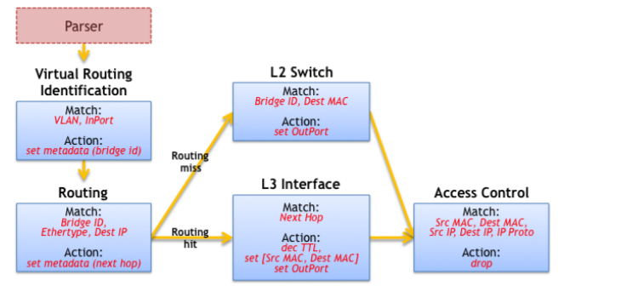

Slide 11
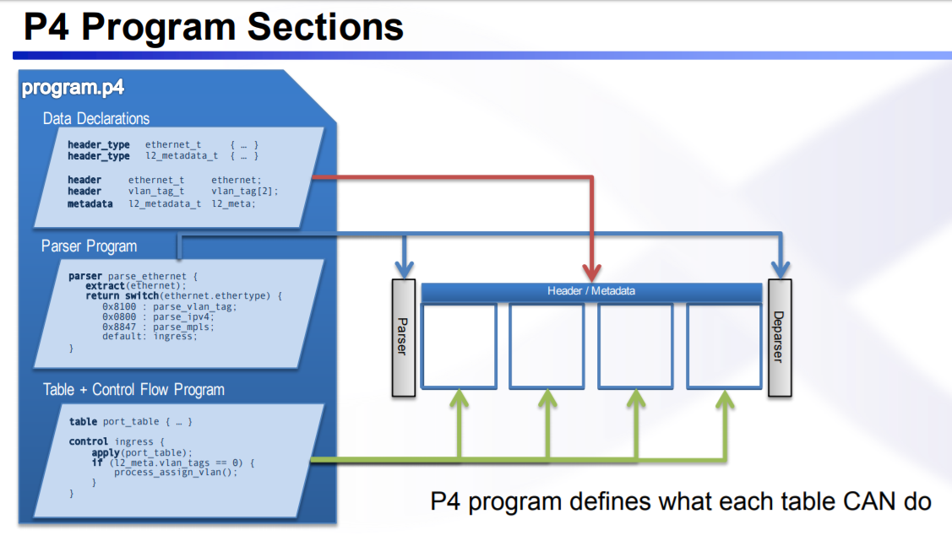

Slide 12
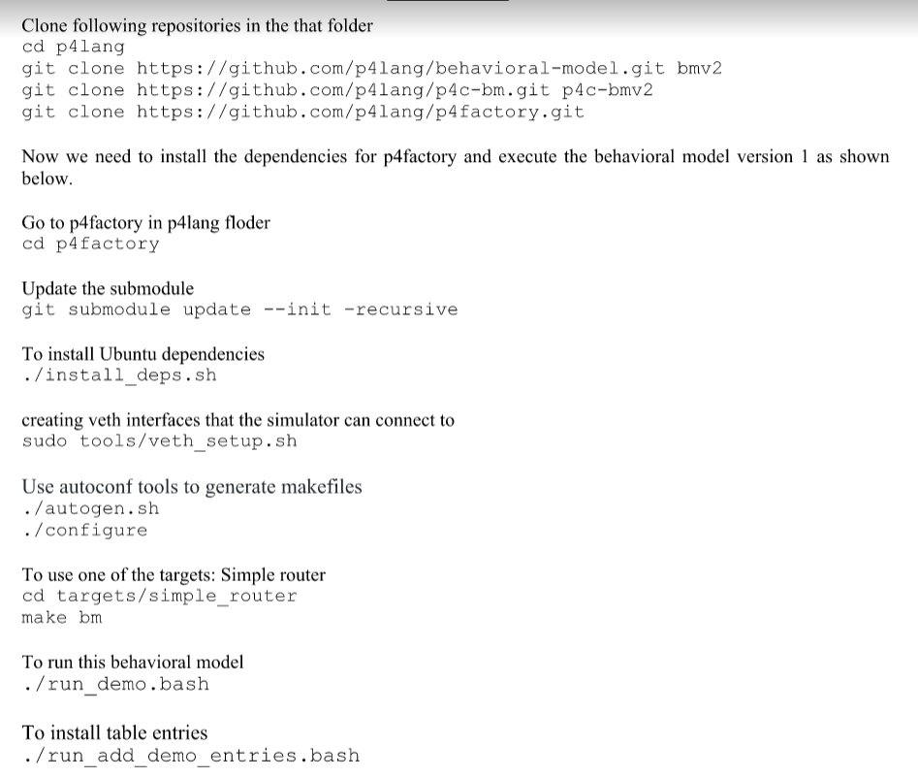

Slide 13
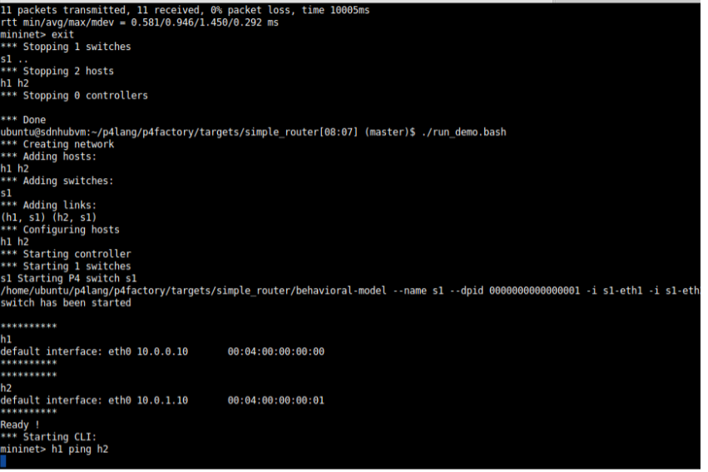

Slide 14
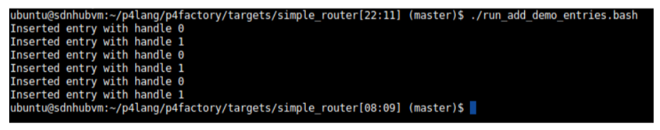
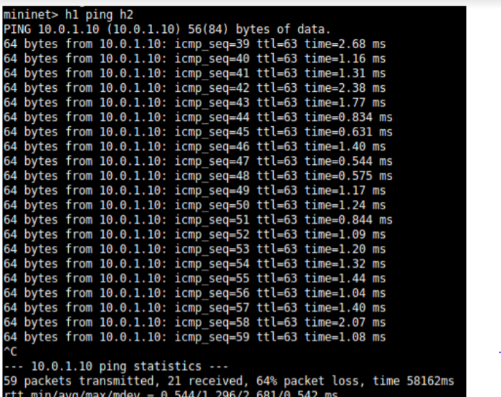

Slide 15
